Slide 1
Project 1
SAT & ACT Analysis
General Assembly DSI14
April 20, 2020
Prepared by : Geoffrey
Jamie
Sharmaine
Song Yuan
Vincent

Slide 2
Presentation Outline
Problem Statement
Methodology
Exploratory Data Analysis
Descriptive & Inferential Statistics
State-focused Research
Recommendation
Conclusion

Slide 3
Problem Statement
Since 2012, many states have enacted law to mandate ACT as the default assessment for high school graduates, giving rise to the popularity of ACT, taking over SAT.
Hence for the College Board, it would be quintessential to understand the reason behind ACT long-lasting popularity and formulate a cost-efficient solution to improve the SAT participation rate.

Slide 4
Methodology
Data Visualization
In this project, we use codes to plot and identify the key questions by comparing ACT & SAT data set.
What is to be studied and learned from ACT & SAT test data of year 2017 & 2018?
Recommendation on how to improve the SAT participation rate?

Slide 5
Methodology
Datasets & Variables
The data reviewed from SAT and ACT datasets for all US states from 2017 and 2018 :
ACT Participation Rates
ACT English Scores
ACT Maths Scores
ACT Reading
ACT Science
ACT Composite Scores
SAT Participation Rates
SAT Evidence-based Reading & Writing Scores
SAT Maths Scores
ACT Total Scores

Slide 6
Methodology
Data Cleaning & Wrangling
The Data is Messy! Clean Up Data
The data were come from different sources so we before we start analysis the data, data study and cleaning is important!
Format
Check the format consistency
Values
Remove the values which is not in use
Cells Rows Columns
Remove empty cells, row or columns
Combine
Combining Datasets
Errors Check
Check for any errors in values
Filter
Filter the errors and do data cleaning
Amend and Analyze !
Amend the error and start analyze !

Slide 7


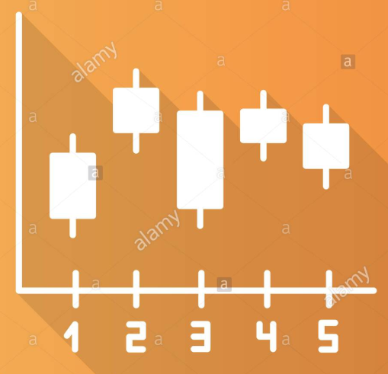
Observations From ACT & SAT
Data Visualization & Exploratory Analysis

Slide 8
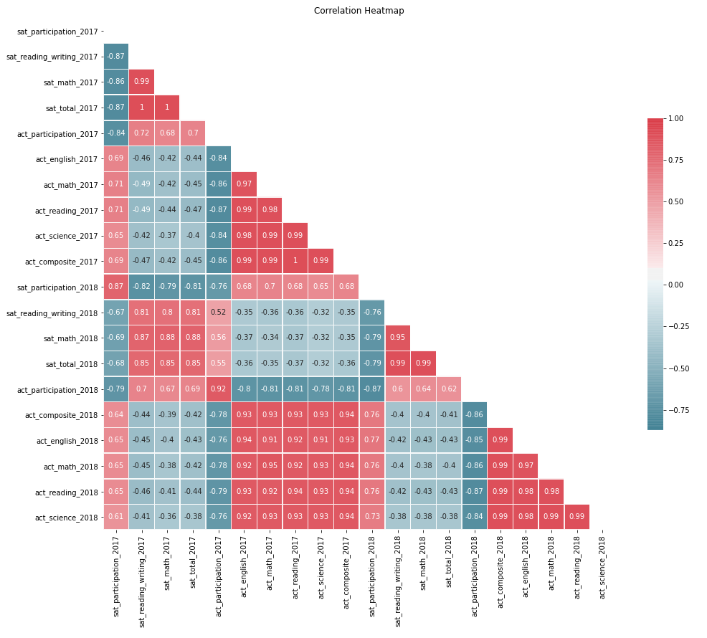
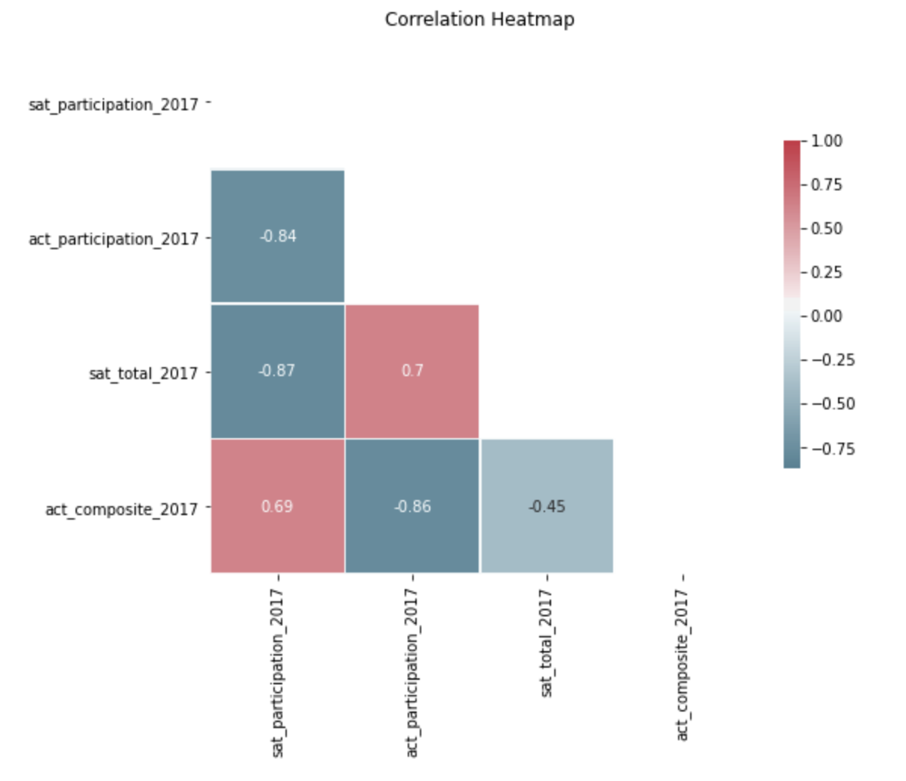
Exploratory Data Analysis (EDA)
Correlation Heatmap
Remove Collinear Variable

Slide 9
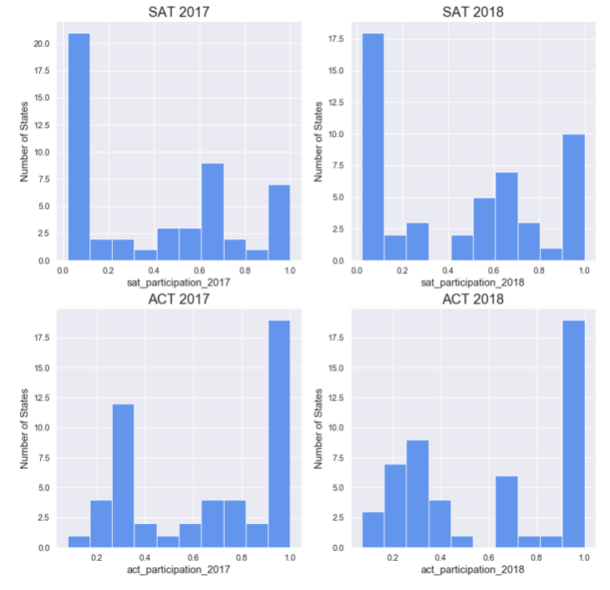
Histogram
Notice the SAT participation rate histograms having left sided peaks
Indicates low participation close to 0% is most frequently occuring
Notice the ACT participation rate histograms having right sided peaks
Indicates high participation close to 100% is most frequently occuring
Could possibly suggest data might influenced by something (Eg: Mandatory state policy to take SAT or ACT)

Slide 10
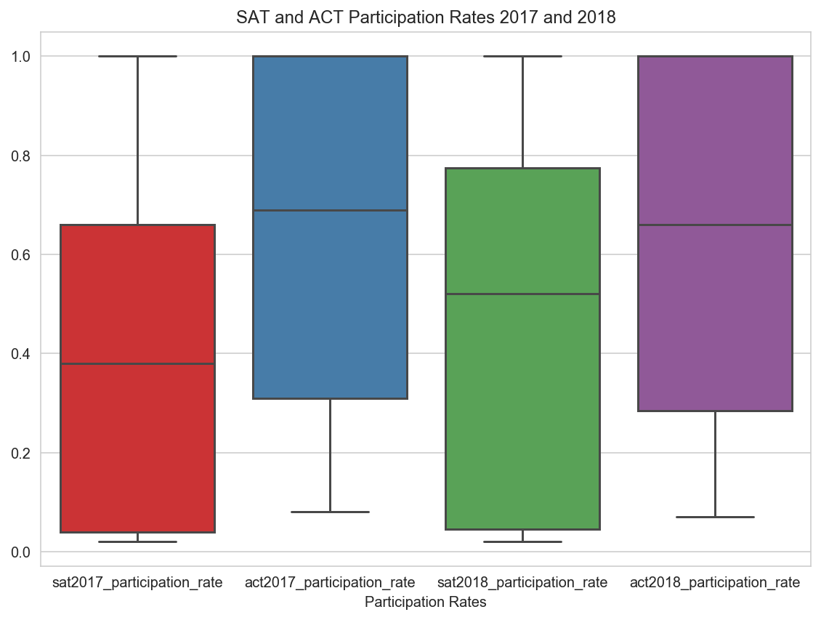
Boxplot
SAT and ACT Participation Rate in 2017 and 2018
Boxplots can help further describe the behavior of the histograms
SAT participation rate 25-50-75 quartiles are around the lower end of participation rates
Has longer top whiskers indicating outliers are high participation rates
ACT participation rate 25-50-75 quartiles are around the higher end of participation rates
Has longer bottom whiskers indicating outliers are low participation rates

Slide 11
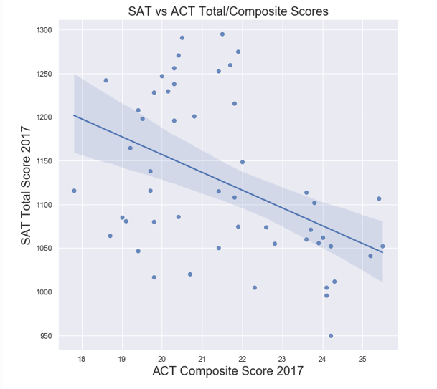
Scatter Plots
ACT Composite Score vs SAT Total Score
ACT & SAT Test Scores
By comparing both ACT and SAT test scores we can identify particular states student performance. Each data hold a relationship with each other. As example, the higher score in one test, the average score for the other will tend to be lower.
The relationship can be seen in the regressed linear line on the scatter plot of comparison ACT composite score and SAT total scores in year 2017.

Slide 12
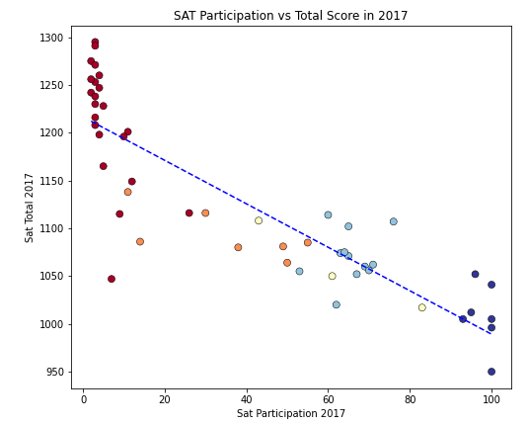
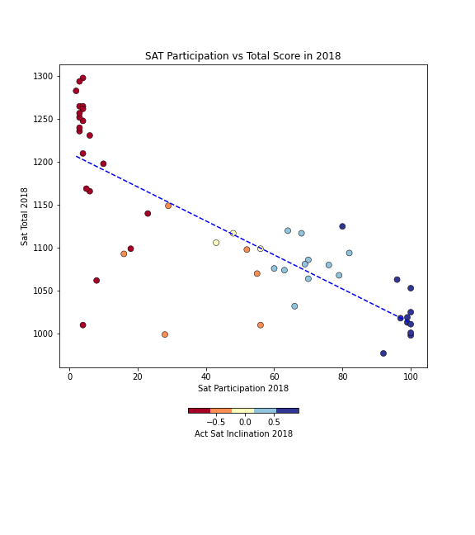
Scatter Plots
SAT Participation vs Total Score
Negative correlation between SAT Total Score and Participation Rate
ACT-Dominated
State
ACT-Dominated
State
SAT-Dominated
State
SAT-Dominated
State

Slide 13
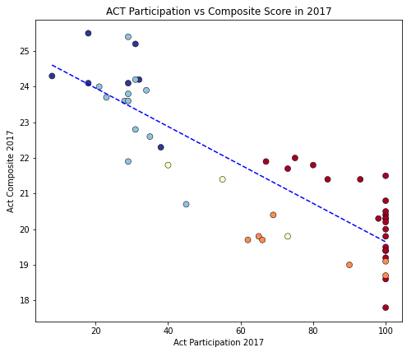
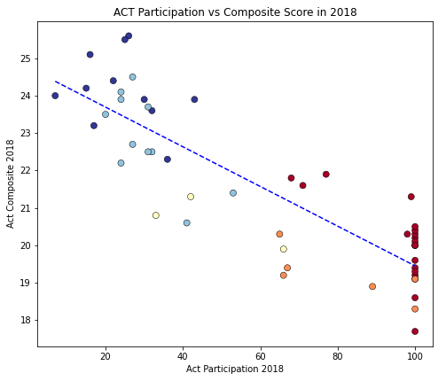
Scatter Plots
ACT Participation vs Composite Score
Negative correlation between ACT Composite Score and Participation Rate
SAT-Dominated
State
SAT-Dominated
State
ACT-Dominated
State
ACT-Dominated
State

Slide 14
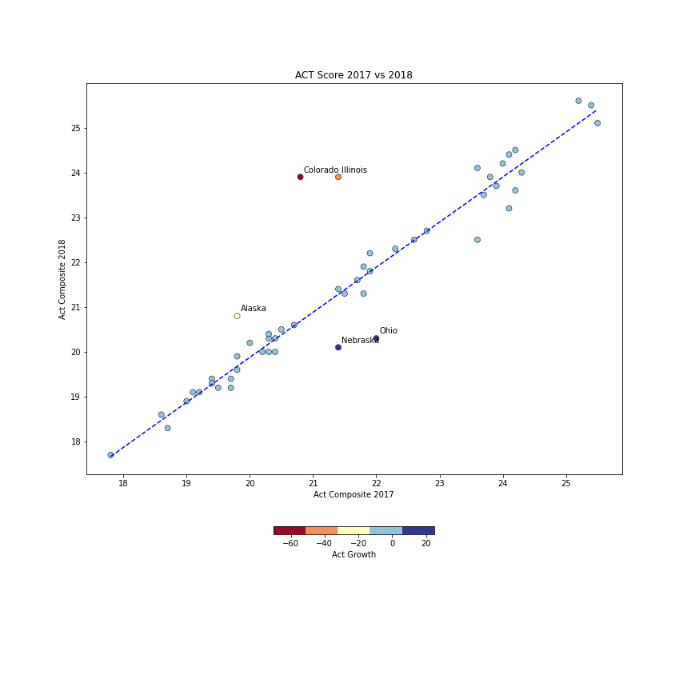
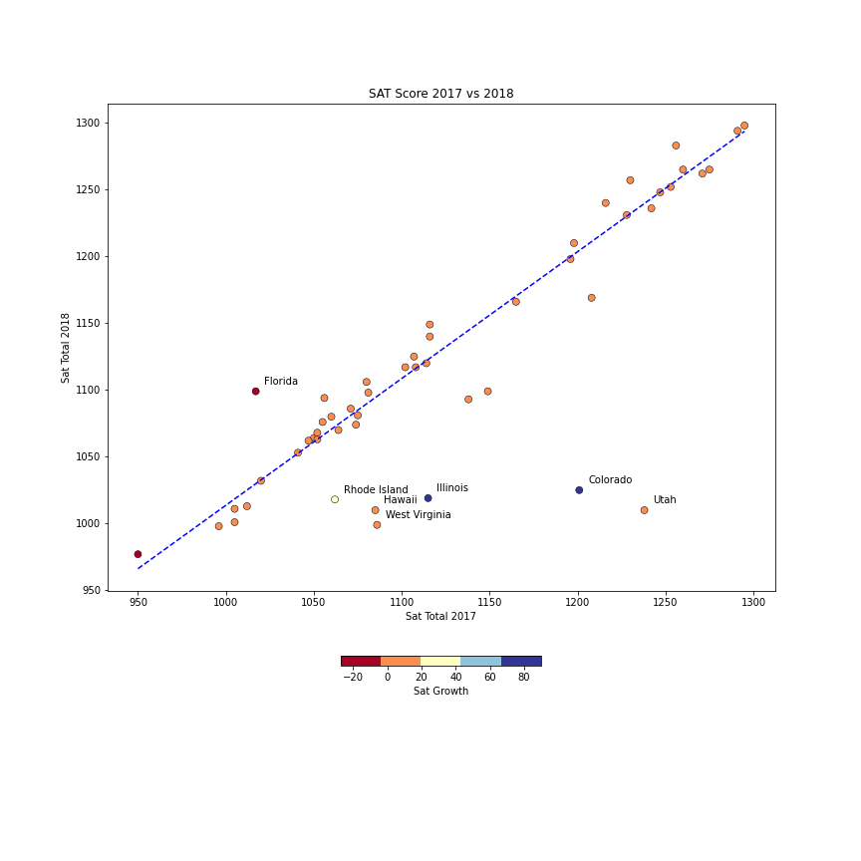
Scatter Plots
Performance Growth in ACT and SAT
Positive correlation between 2017 & 2018 performance for both SAT & ACT
Improvement
Zone
Improvement
Zone
Deterioration
Zone
Deterioration
Zone

Slide 15
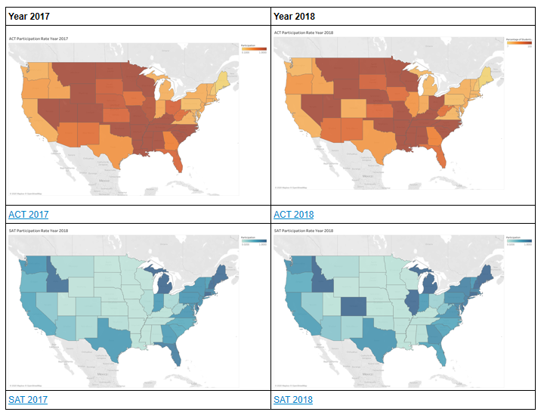
Choropleth Map
Distribution of SAT and ACT in United States
Participation Rates
By comparing the choropleth map which indicated in darkest orange color represents the 100% participation rate of ACT test while darkest blue indicate the 100% participation rate of SAT test.
The ACT is more concentrated in central of US while SAT is popular in coastal states.

Slide 16
Outside Research
We have chosen 3 states for further research:
Colorado: 100% ACT participation rate in 2017, then a 100% SAT participation rate in 2018.
West Virginia: 4% decrease in ACT participation rate from 2017 to 2018, and a 14% increase in SAT participation rate from 2017 to 2018
Ohio: 75% ACT participation rate in 2017, it increases to 100% ACT participation rate in 2018. There is also a 6% increase in SAT participation rate from 2017 to 2018

Slide 17
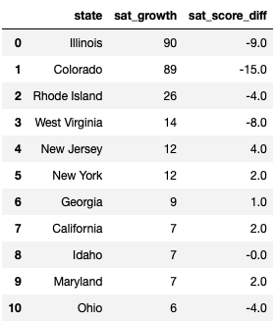
Outside Research
Top SAT Growth States

Slide 18

Case Study - Colorado
In 2017, Colorado had a change in state policy which adopted the SAT over ACT for the class of 2018 as mandatory college entrance exam. The policy change can be seen impacting the change of the Colorado SAT participation rate in 2018.
Similar policy change has also been witnessed in Illinois, where it has caused a 90% hike in SAT participation rate as well.
source: https://chalkbeat.org/posts/co/2015/12/23/goodbye-act-hello-sat-a-significant-change-for-colorado-high-schoolers/

Slide 19
State-mandated Assessment
8 States with Policies for mandatory SAT:
Colorado
Connecticut
Delaware
District of Columbia
Illinois
Maine
Michigan
New Hampshire

Slide 20
State-mandated Assessment
13 States with Policies for mandatory ACT:
Alabama
Hawaii
Montana
Nebraska
Nevada
North Carolina
North Dakota
Utah
Wisconsin
Kentucky
Louisiana
Mississippi
Wyoming

Slide 21
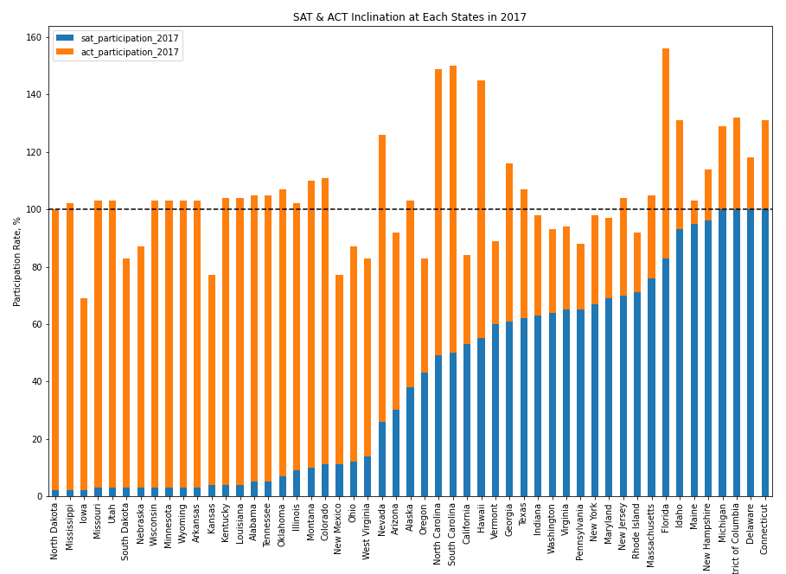
State Participation Rates
As shown above, generally a state would either be inclined to SAT or ACT
However, there are several states that have very high participation for both the assessment
More than half of the states have a combined participation rate of more than 100%
It means that it is common in most of the states for student to take both SAT and ACT
Especially in Florida, North Carolina, South Carolina and Idaho, which 3 of them are at the East Coast.

Slide 22
Case Study - West Virginia
West Virginia had a increased in students taking SAT due to SAT school day, in which the state covers the SAT costs and the tests are conducted on a school day. This explains in the increase of participation rates in SAT.
Apart from that, West Virginia is relatively neutral in term of inclination towards SAT or ACT. There is no state policy favorable to either assessment, so the SAT school day would be more effective in West Virginia.
source: https://blog.prepscholar.com/which-states-require-the-act-full-list-and-advice

Slide 23
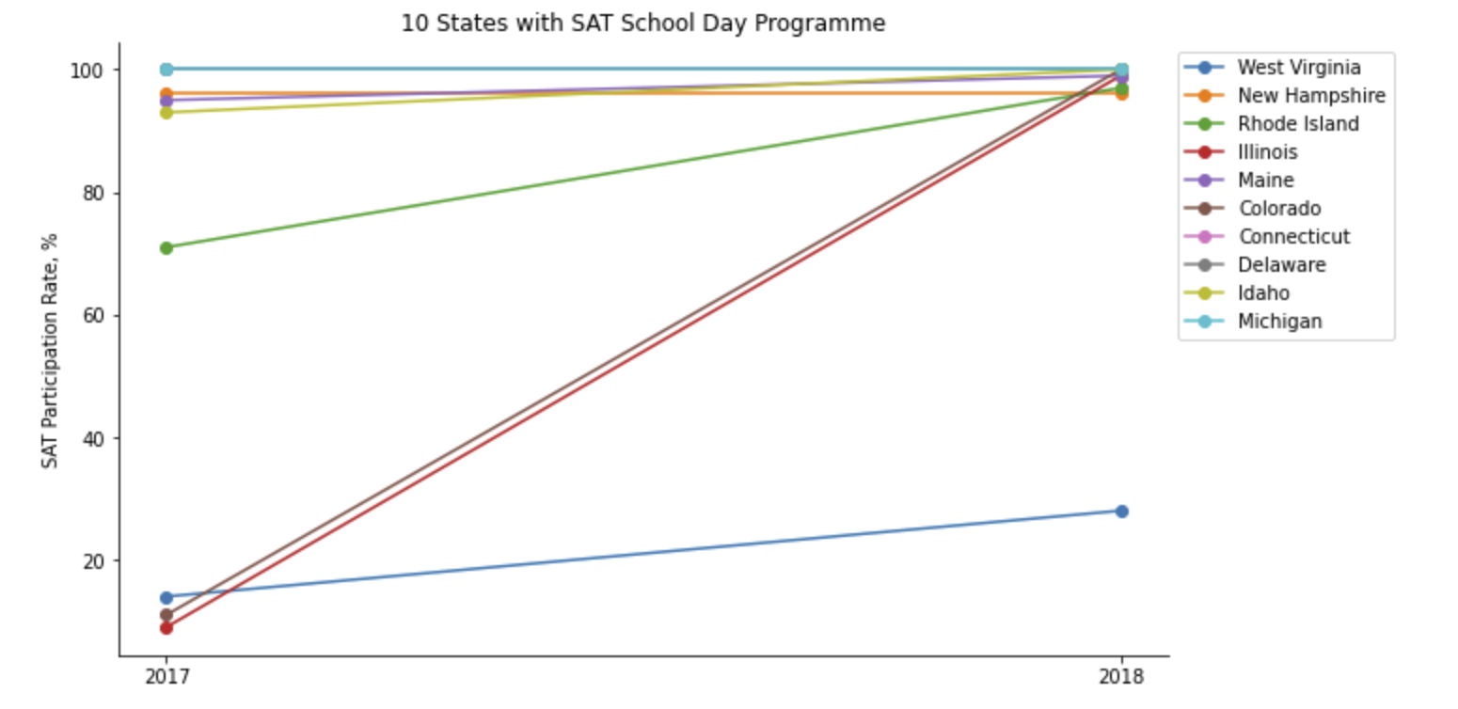
SAT School Day Implementation
Rhode Island
Illinois & Colorado
West Virginia
All the states under the programme are on rising trend, including states with near 100% participation rate.

Slide 24

Case Study - Ohio
In Ohio, the class of 2018 was the first class where the state-government would fully subsidized for all students to participate in the ACT. The subsidy has encouraged thousands of the - otherwise - non college-bound students to take the ACT.
It has caused the ACT participation to hike from 75% up to 100% in Ohio.
College board may emulate the success of ACT in Ohio by lobbying with selected state government to subsidize for SAT.
source: https://www.daytondailynews.com/news/national-act-scores-for-class-2018-worst-decades-officials-say/EKA05C3FHcjN4bx8BmcC2N/

Slide 25
Recommendation and Conclusion
Recommendation
SAT school day helps to increase the participation rate for SAT. Increase collaboration with state education authorities to take up the program of SAT school day.
In West Virginia, the SAT School Day Programme has gained its momentum, so College Board may leverage on this by marketing and lobby for further Government support.
Encourage the College Board to ramp up engagement with the state's education authorities to consider making SAT mandatory for all students in the state.
Conclusion
We would like to obtain the data for the annual education budget for the states as the 3 recommendations would require funds from the state in order for it to get implemented.
Knowing which state has an increased in budget would help our recommendations to succeed.

Slide 26
THANK YOU!

